Slide 1



TO CHALLENGE
COMPLEXITY
WE BRING NEW PERSPECTIVES
TO MAKE OUR CLIENTS´ LIVES EASIER

Slide 2


Client Segmentation
19/04/2022
Proposal to Sense Assurance ㋏

Slide 3










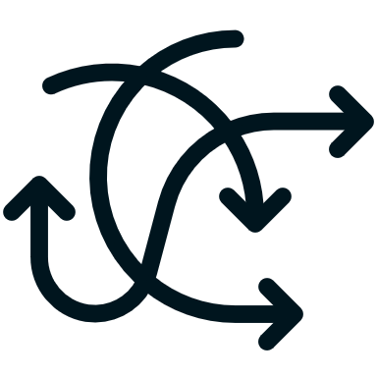

index
1. Goal
6. Challenges
The problem at hands
Roadblocks faced in the project
2. Data
7. Technical Details
Resources to build the solution
How the solution was achieved
3. Proposal
8. Delivery
Our solution proposal
Implementation of solution
4. Results
9. Next Steps
The solution results
What can we do next?
5. Roadmap
10. Q&A
Steps to build the solution
Discussion
3

Slide 4


Goal
The Problem at hands
4

Slide 5

Sense Assurance marketing problem
The Marketing department came to us with a problem. Their volume of clients is increasing rapidly, and they are having difficulties profiling their old and new clients.
They want to automate their client profiling. Technically, these are client segmentations.
The segmentation goal is to answer these questions
Most valuable clients currently;
Most valuable clients in the future;
Clients who have certain Lines of Business (LOB’s);
**** Outras questões;
*definir bem o que estamos à procura nos clusters
5

Slide 6
Data
Resources to build the solution
6

Slide 7


provided data
Sense Assurance provided us with a dataset composed of ~10k clients information.
These informations are:
About the client
Age;
Degree of Education;
Monthly Salary;
If has children;
Living Area;
About the business
First Policy Year
Customer monetary value;
Claims Rate
Premium: Motor
Premium: Household
Premium: Health
Premium: Life
Premium: Work Insurance
7
7

Slide 8

Proposal
Our solution proposal
8

Slide 9


proposal
Our goal is to segment the clients in ways that describe meaningful patterns.
The goal questions are the basis to evaluate these patterns.
Thus, we propose an unsupervised solution to this problem. The quality of the solution is weighted by sophisticated metrics, but also by analysing the segments to assess if the desired patterns of the goal questions are answered.
Unsupervised Clustering proposed methods
Kmeans
DBSCAN
Agglomerative Clustering
9

Slide 10

Results
The solution results
10

Slide 11

Roadmap
Steps to build the solution
11

Slide 12

Challenges
Roadblocks faced in the project
12

Slide 13

Technical Details
How the solution was achieved
13

Slide 14
Delivery
Validation of results
14

Slide 15

Next Steps
What can we do next?
15

Slide 16
Q&A
16

